Slide 1
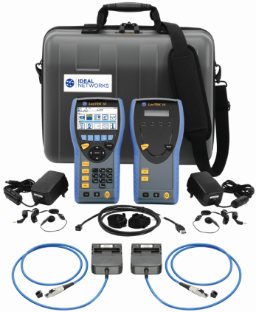
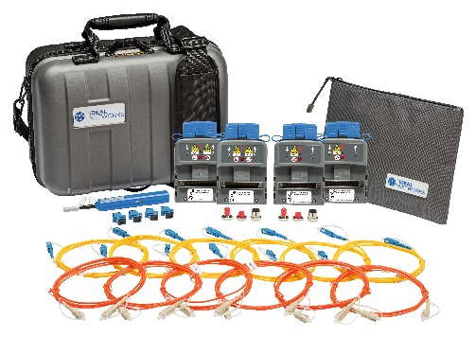
Product Launch Plan
LanTEK® III
FiberTEK® III
November 2015

Slide 2
Agenda
History
Market background
Standards and trends
LanTEK III and FiberTEK III:
Product application & target customers
What has changed - LanTEK III and FiberTEK III
Product specs LanTEK III, housing and UI
New test parameters
New test adapter and cost of ownership
Accessories
IDEAL DataCENTER and IDEAL AnyWARE
Modular approach – buy what you need
Pricing: LanTEK III and FiberTEK III
Competitor comparison
Introduction FiberTEK III
Product specifications
Encircled Flux
Field calibration
Measurement and analyse mode
Port finder
FAQ & critical questions
Marketing material
Service & Careplan’s
End of life of LanTEK II and FiberTEK FDX
Note: There are a number of slides marked as “INTERNAL”, all other slides may be shown to 3rd parties

Slide 3
History
2016: IDEAL INDUSTRIES - 100th Anniversary
More than 22 years knowledge and experience in
cable testing and certification
Wide portfolio ranging from simple cable verifiers up to cabling certifiers
LanTEK III: 7th generation of cabling certifiers

Slide 4
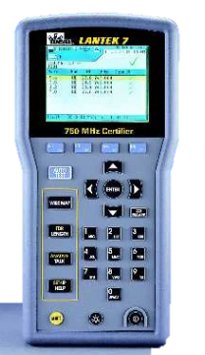
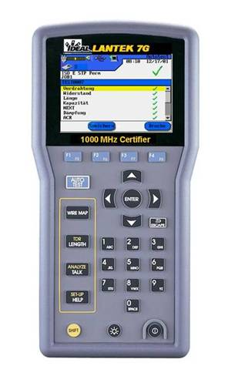
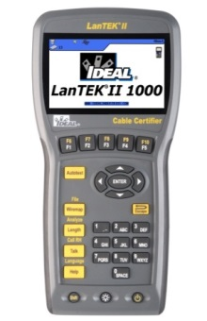
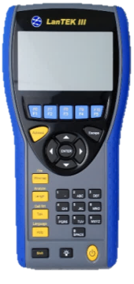
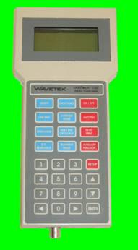
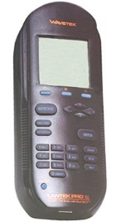
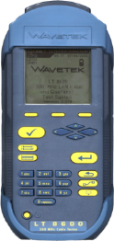



History
LanTEK 6 / 7
Series
LanTEK 6A / 7G
Series
LanTEK II
Series
LanTEK III
Series
LanTEK 10 / 100
Series
LanTEK PRO / PROXL
Series
LanTEK 8000
Series
1993
1995
1998
2001
2005
2009
2015

Slide 5



Background on Standards
Tester Accuracies, Cabling Standards and Applications
Ethernet
Speed
Cabling
Standard
Max
Frequency
Accuracy
10Gbit/s
25Gbit/s
40Gbit/s
NBaseT
10Gbit/s
10Gbit/s
Up to 30m
1 Gbit/s
CAT8
Class I, II
CAT7A
ISO F_{A}
?
$≤$CAT6A
$≤$ISO E_{A}
CAT6A
ISO E_{A}
ISO F
CAT5E/ CAT6
ISO D / ISO E
1GHz
2GHz
600MHz
?
$≤$500MHz
500MHz
100MHz
250MHz
level V
?
level VI
level IIIE
level IV
Level Iie
level III
$≤$level IIIE
Existing standards : Solid lines No standards yet : Dotted lines
Grey background
Notes:
Overview of cabling standards

Slide 6
Background on Standards
ISO and TIA working groups are in place to develop proposals for cabling supporting 40GBit/s
Ethernet up to 30m max. cable length
ISO will summarise this work in a technical report ISO TR 11801-99-1
IEEE NWIP for 25GBit/s and NBaseT
  Not yet clear which cabling shall be used
New CAT8 cabling
  Solution up to max. 30m
  TIA : 2000MHz over RJ45
  ISO: 2000MHz on non RJ45
  ISO: 2000MHz over RJ45
40GBit
CAT8 Class II cabling up to
2000 MHz
TERA / GG45
CAT8 Class I cabling up to 2000 MHz
RJ45
TIA CAT 8 cabling up to 2000MHz
RJ45

Slide 7
CAT 8 and 40Gbit over Twisted Pair
Big Goals and Many Open Questions
  Goals of TIA and ISO
    TIA : 2000MHz over RJ45
    ISO
      2000MHz over RJ45
      2000MHz over TERA and GG45
    IMPORTANT: ALL drafts contain length restrictions (up to 30m max!)
  CAT8 is optimised for 40GBit in data centres
  Open questions
    ISO and TIA limits not settled
    – there are only drafts for CHANNEL limits available
    No standards for CAT8 components yet
    IEC will launch a new standards project for measurement accuracies up to 2000MHz in autumn 2015
    New measurement parameters under discussion!

Slide 8
CAT 8 and 40Gbit over Twisted Pair
Big Goals and Many Open Questions
  Summary
  First of all, standards committees need to agree on what at all needs to be tested in the field!
  Possibly new measurement parameters and new frequency ranges can earliest be adopted into future releases of ISO/IEC 61935-1 and EIA/TIA-1152.
  Future editions with CAT8 support are still years out!
  WARNING: Until then, there is no normative reference at all for field testing up to CAT8
  As long as the standards for cabling as well as testing are not ratified, an installer would work outside of any normative reference and legal basis
  As an installer of the cabling system, the installer carries the product liability for the product “installed CAT8 cabling for 40GBit/s” In a legal dispute (e.g if the cabling in future will not support 40Gbit/s) , the installer would be held liable because a measurement method was used that bared any normative reference and therefore would not be valid at court
    => A lot of basics are still missing!

Slide 9
CAT 8 and 40Gbit over Twisted Pair
Big Goals and Many Open Questions
Would 40GBit/s = 40000MBit/s make sense in horizontal cabling?
  Bandwidth of a normal PC network interface : 1000MBit/s
  Examples for extremely high bandwidth:
    Streaming Blue Ray Disk : 40MBit/s , Utilisation of the network card : 4%
    Streaming HDTV (max) : 15MBit/s , Utilisation of the network card : 1.5%
    Streaming 8K UHDTV :183MBit/s, Utilisation of the network card : ~18%
    (btw : How many UHDTV streams do you want to watch simultaneously on one device??)
  A 40 ! times higher bandwidth for a network card would not make sense for normal desktop applications and would only increase cost
  Exception: Video editing over the network
  Professional video editing over the network requires higher bandwidth because the caching of files is very bandwidth intensive
  This also requires very powerful server structures in the background
  => Data Centre application for 10GBIt/s (sufficient!)

Slide 10
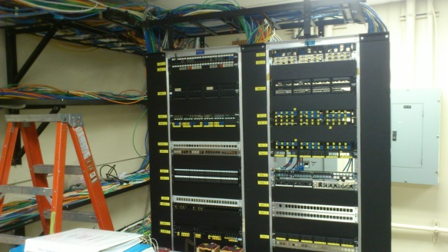

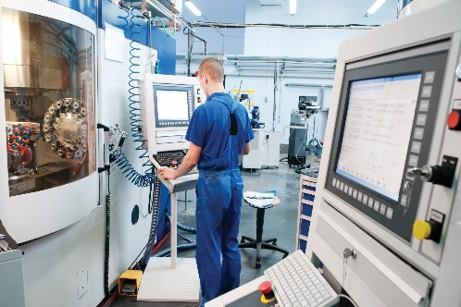
Product Application LanTEK III
The main applications for LanTEK III is the testing of twisted pair data cabling in LAN and campus applications. Its key feature is to test compliance to international standards and to troubleshoot links when failures occur.
The test can be carried out during installation as well as for fault finding
Installation of data cabling for:
Commercial building LAN infrastructure
Datacentres
Building automation
Industrial Ethernet
Wide range of adapters makes LanTEK III very versatile

Slide 11
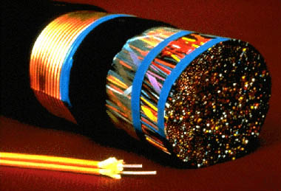
Product Application FiberTEK III
The main applications for FiberTEK III is the testing of fibre optic MM and SM cabling in LAN and campus applications. Its key feature is to measure attenuation and length of a fibre optic link. (also known as “Tier 1 Certification”)
The test can be carried out during installation as well as for fault finding
Installation of:
building backbone cabling (“secondary cabling”)
inter building cabling and campus cabling
(primary cabling)
FTTD (Fibre To The Desk) cabling (“tertiary cabling”)
Cabling for building automation
Cabling for industrial automation
Satellite antenna cabling

Slide 12

Target customers
Installers of LAN data cabling
  Small electrician, also installing “data”
  Medium to large size installation company ( electrical and data )
  Large installation companies
  (electrical, data for commercial buildings as well as data centre)
  Industrial cabling installers
  Small Office Home Office (SOHO) installers
  …
End users
  Equipment manufacturers (e.g. shipyards, patch cable manufacturers)
  Facility maintenance personal of large enterprises (e.g banks, insurances)
  Public sector (e.g army)
  Professional testing and troubleshooting companies
  …
Rental companies (including distributors renting equipment to users)

Slide 13


Introduction
IDEAL Networks is pleased to announce the introduction of the LanTEK III series of cabling certifiers and FiberTEK III fibre test options

Slide 14
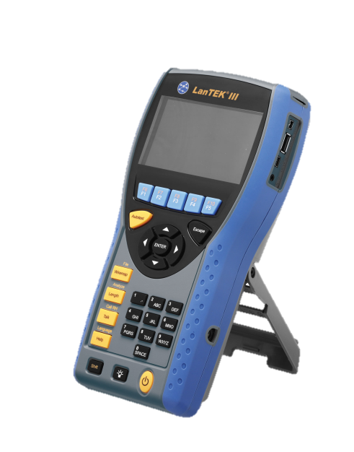
Introduction
This series will supersede the LanTEK II and FiberTEK FDX series
The main development drivers are as follows:
Address users real application needs, focus on making the day to day installation process easier and faster
Easy user interface
Easier interpretation of results
Easy to use troubleshooting functions to solve installation issues quickly
Highly durable product with durable replacement parts
Low cost of ownership
Sending test data from the jobsite
New fibre test options -> FiberTEKIII

Slide 15
Highlights
What is new in LanTEK III?
New housing, IDEAL Networks look
  More rubber protection for a hard life on construction sites, better ergonomics
  Networks colour scheme
New user interface in Networks style
New troubleshooting functions for better fault detection along the cabling
  TDX: Time domain crosstalk
  TDRL: Time domain return loss
New permanent link adapter
  highly durable adapter with replacement tips reduce cost of ownership
New ordering system
  Buy only what you really need
New PC Software IDEAL DataCENTER 2.5
New wireless connection to smartphones (IOS and Android) to IDEAL AnyWARE app
  Send test reports directly from smartphone to e-mail or cloud

Slide 16
Highlights
What is new in FiberTEK III?
Dual port testing
Integrated red light source
Uni- and bi-directional measurement
1 and 3 jumper field calibration
Accessories for multimode Encircled Flux compliance
LC adapters
Loop mode

Slide 17
Highlights
What stays the same in LanTEK III?
New look and feel user interface however the basic structure will stay the same therefore users that know LanTEK II will have no trouble to migrate to LanTEK III
LanTEK II and LanTEK III share the same copper channel adapters and other accessories like chargers and batteries
The top model LanTEK III is a 1000MHz tester
IDEAL DataCENTER, (but new revision 2.5 !)
What is different between LanTEK II and LanTEK III ?
There is no 350MHz version anymore
There is no FiberTEK MM LASER version anymore
LanTEK II cannot use the new PL adapters and troubleshooting methods
LanTEK III cannot use FiberTEK FDX
LanTEK II cannot connect to IDEAL AnyWARE
LanTEK II will be compatible with FiberTEK III (planned for 2016)

Slide 18
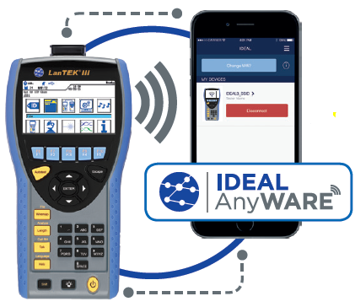
LanTEK III

Slide 19
Product Specifications
LanTEK III is the 7th generation of IDEAL certifiers and the 3rd generation of
LanTEK
The new generation will consist of 2 models
LanTEKIII-500MHz (up to 500MHz)
LanTEKIII-1000MHz (up to 1000MHz)
Compatibility Chart
 | LanTEK 6,6A ,7 and 7G Series | LanTEK II Series | LanTEK III Series
FiberTEK/ TraceTEK | ✓
FiberTEK FDX |  | ✓
FiberTEK III |  | ✓ | ✓
Copper CH adapters | ✓ | ✓ | ✓
Copper PL adapters |  |  | ✓
Batteries / chargers |  | ✓ | ✓
IDEAL AnyWARE |  |  | ✓
IDC | ✓ | ✓ | ✓

Slide 20
Product Specifications
Features | LanTEK III-500MHz | LanTEK III-1000MHz
Frequency range | 500 MHz | 1000 MHz
Cable specification CAT 3/ISO C, CAT 5/ISO D, 5e/D new, 6/E | Y | Y
Cable specification CAT 6A/ISO EA | Y | Y
Cable specification ISO F, ISO FA | Upgradeable | Y
Accuracy level III / IIIe / IV (LanTEK®II) | IIIe (ETL) | IIIe / IV (ETL)
DualMODE™-tests | Y | Y
Permanent Link test with patch cord for non RJ45 connectors | Y | Y
Permanent Link test with permanent link adapter for RJ45 connectors | Y | Y
CAT 6 test storage capacity with graphs | 1700 | 1700
USB port | Y | Y
Serial port (concerns only service) | Y | Y
Fibre loss and length measurement (FiberTEK™ III) | Optional | Optional
Communication over fibre and copper | Y | Y
LCD-display on remote handset (RH) | Y | Y
Tone generator to determine connection on near and remote end | Y | Y
Lithium-ion battery packs | Y | Y
Wireless connection to IDEAL AnyWARE™ app | Y- External adapter included | Y- External adapter included

Slide 21
Product Specifications
Features | LanTEK III-500MHz | LanTEK III-1000MHz
Standard test compliance | ANSI/TIA/EIA 568A, 568B, 568-C2 CAT 6A/6/5E/3, ISO EA/D/C, AS/NZS 3080, IEEE 802.3 Ethernet, EN50173 – EA/E/D/C | ANSI/TIA/EIA 568A, 568B, 568-C2 CAT 6A/6/5E/3, ISO F/EA/D/C, AS/NZS 3080, IEEE 802.3 Ethernet, EN50173 – F/EA/E/D/C
Cable types | UTP/SCTP/FTP CAT 3/5E/6A/7/7A (100 Ω); Coax (50/75 Ω)
Dimensions | (L) 254 mm x (W) 127 mm x (D) 53 mm
Weights | Display handset (DH) 1180 g (incl. battery) Remote handset (RH) 1120 g (incl. battery pack) Battery pack 548 g
Battery packs | Lithium-ion battery packs (Li-ion)
Operating life with battery pack | 18 HOURS continuous use
Charge time | In handset 6-8 hours External 4 hours
Operating temperature | 0º C to +50º C (only operate if handset temperature is close to ambient temperature!)
Storage temperature (min/max) | -20º C to +70º C
Relative humidity | 5% to 90%, noncondensing

Slide 22
Product Specifications
LanTEK III | Range | Resolution | Accuracy
Length (50 - 100 Wcable) | 0 – 605 m | 0.1 m | + (3 % + 1 m)
Delay | 0 - 8000 ns | 1 ns/0.1 m | + (3 % + 1 ns)
Average impedance | 35 – 180 | 0,1 | + (3 % + 1 )
Capacitance (bulk) | 0 - 100 nF | 1 pF or 3 digits | + (2 % + 20 pF)
Capacitance | 0 - 333 pF/m | 0.1 pF | + (2 % +1 pF)
DC loop resistance | 35 -200 | 0,1 | + (1 % + 2 )
Attenuation | 1 MHz - 1 GHz | 0.1 dB | Level III/IIIe/IV
NEXT (crosstalk) | 1 MHz - 1 GHz | 0.1 dB | Level III/IIIe/IV
Return loss | 1 MHz - 1 GHz | 0.1 dB | Level III/IIIe/IV
ELFEXT / ACR-F | 1 MHz – 1 GHz | 0.1 dB | Level III/IIIe/IV
ACR / ACR-N | 1 MHz – 1 GHz | 0.1 dB | Level III/IIIe/IV
TDX | 0-150 m | 0.1 m | N/A
TDRL | 0-150 m | 0.1 m | N/A

Slide 23
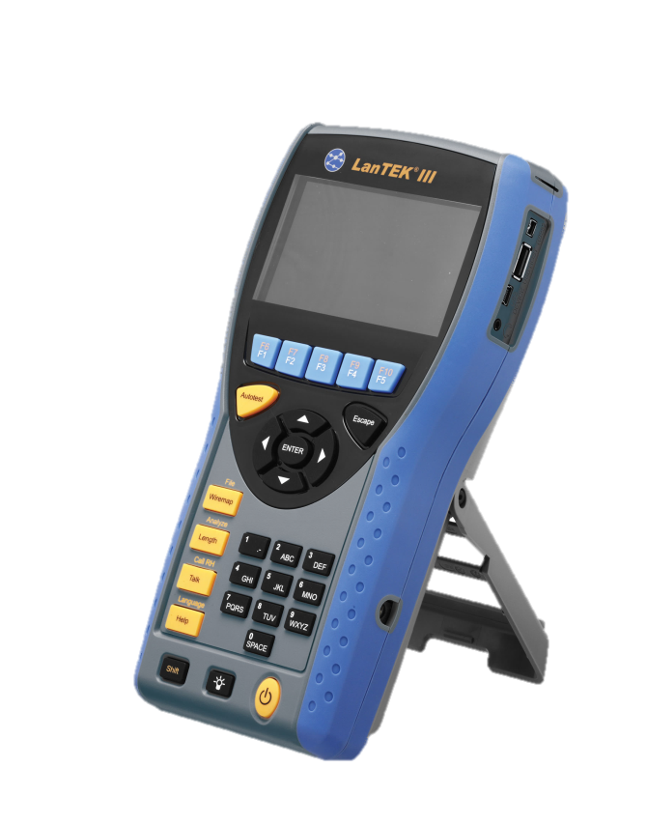
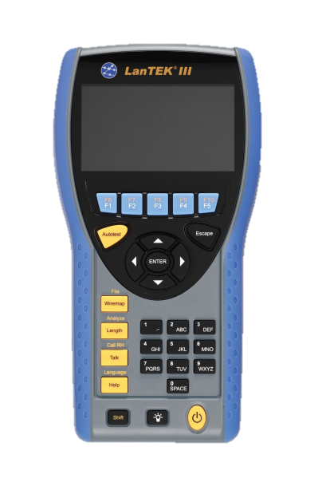
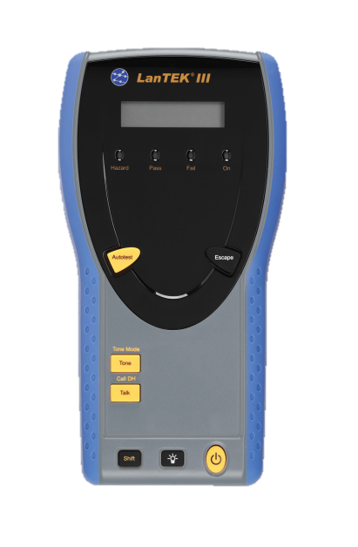
Housing
New housing
More rubber for better protection in the field – but not too much rubber so that it does’nt feel clunky
Keyboard slightly re-arranged for better ergonomics
Grooved kickstand to hang units on rack doors
Re-arranged keyboard
Grooved kickstand
Protection

Slide 24
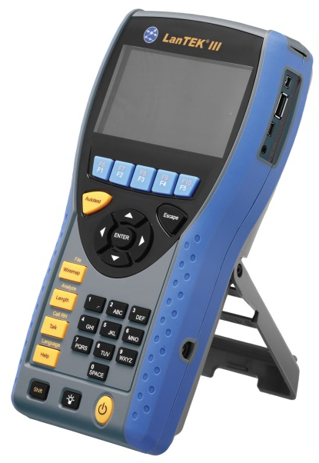
Housing
Rubber over mould for good grip as well as protection
2 USB Ports (master, slave)
Wi-Fi (@ USB master)
3.5mm audio socket for talk-set
Large bright colour display
Display protection for use on construction sites
Grooved kickstand to hang units on rack doors
Ergonomic keyboard for easy data entry
Quick access buttons for most used features
Units operate with and without batteries, even when battery is fully discharged

Slide 25
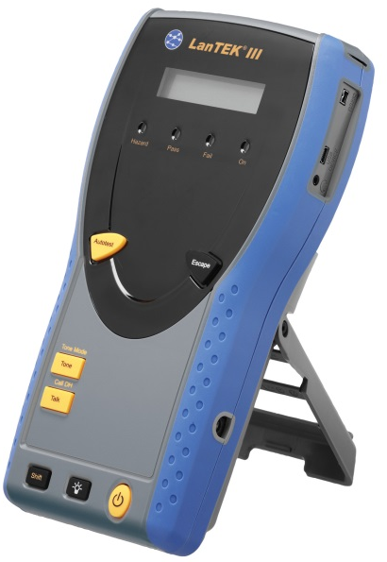
Housing
Built in tone generation for wire and cable tracing
Status screen
Display protection for use on construction sites
USB Port for software upgrade
3.5mm audio socket for talk-set
Quick access buttons for most used features
Units operate with and without batteries, even when battery is fully discharged

Slide 26
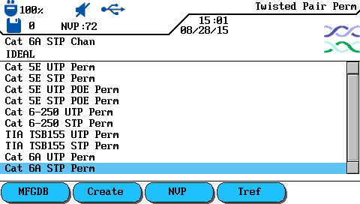
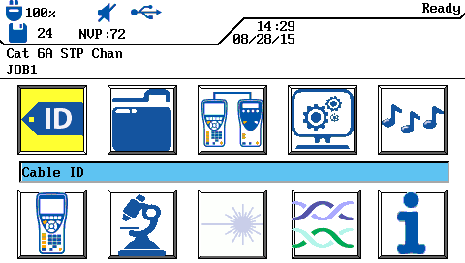
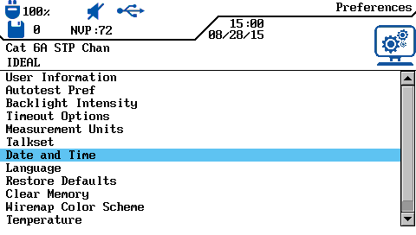
New User Interface
New user interface in Networks style
Similar set of icons within IDEAL Networks testers
Easier to use multiple testers from IDEAL Networks

Slide 27
New Test Features
New troubleshooting functions for better fault detection along the cabling
Precisely detect faults along the cabling using TDX and TDRL technology
  Helps the user to determine if and where components are bad
  Helps to find cabling damages
TDX: Time Domain Crosstalk
  Graphical representation of crosstalk event on the link
  Crosstalk is mostly caused by bad connections (connector or socket)
  or bad termination in a multi connector link, eg links containing consolidation points.
  TDX greatly helps to determine which of the connections is faulty
TDRL: Time Domain Return Loss
  Graphical representation of return loss events on the link
  Return loss is mostly caused by impedance miss-matches due to damages on the cable
  but also due to problems in connectors

Slide 28
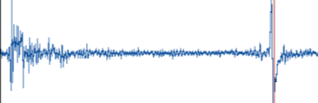
New Test Features
New troubleshooting functions for better fault detection along the cabling
Time Domain techniques – more details
  LanTEKIII is able to convert some of the frequency based measurements
  into time based measurements
  Once a measurement is converted into “time domain”, time can be converted into distance using the NVP factor of the cabling
  The distance information can be used to locate “events” along the cabling where e.g. excessive crosstalk happens
Conversion
frequency domain
to
time domain
Crosstalk
[dB]
Amplitude
[%]
Limit
Example:
Link fails on Crosstalk
TDX shows that there is
excessive Crosstalk after 18 m
Consolidation point faulty?
Distance [m]
1m 18m
1MHz 500MHz f[MHz]
“Frequency Domain” “Time Domain”

Slide 29
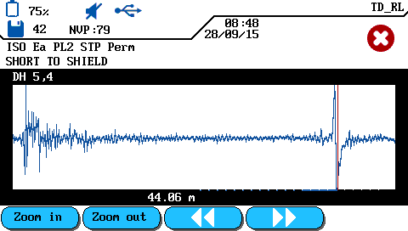
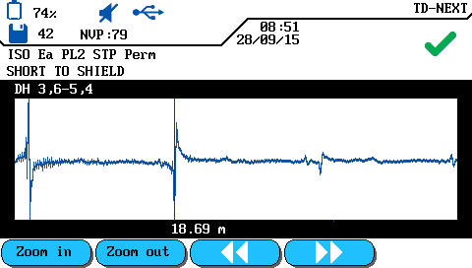
New Test Features
New troubleshooting functions for better fault detection along the cabling
TDX - Example: Consolidation Point
TDRL – Example: Short between pin 5 and shield
First connector @ PL adapter
Consolidation point @18m from tester
First connector @ PL adapter
Short between pin & shield @ 44m

Slide 30
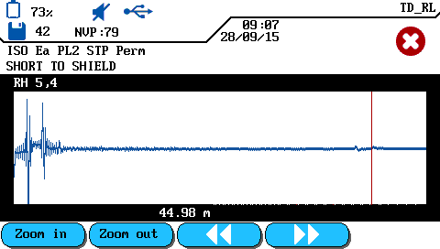
New Test Features
Both TDRL and TDX are available from both the DH and RH set !!
=> You can “look” into the cabling from both sides
Example:
New troubleshooting functions for better fault detection along the cabling
SAME LINK!
Other end of cable is not visible because of the short!
First connector @ DH PL adapter
Short between pin & shield @ 44m seen from DH !
Short between pin & shield @ 1.7m seen from RH !

Slide 31
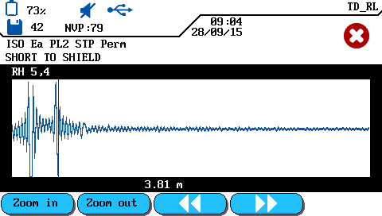
New Test Features
Test from both sides for better resolution
Previous example:
  The short @44m was seen as a single
  event by the DH but seen as
  2 events from the RH
  Because the RH is closer to the even than
  the DH, the distance resolution is better
  There is an “event” with a short and
  an additional “event” about
  2m further into the cable
Short between pin & shield @ 1.7m seen from RH !
Additional connector !

Slide 32


New Test Features
Test from both sides –
See faults that are very far away
New example:
  Short to shield after 119m
  When looked at from DH, fault is too far away
  When looked at from RH, fault is visible
  Cable attenuation changes the amplitudes of both
  TDX and TDRL!

Slide 33
New Test Features
TDX and TDRL – how good is it really?
Things you probably can´t detect
  Fine kinks in the cable
  (often even a tight knot actually does not fail a link!!)
  Good connectors (eg. CP connectors) beyond 30-40 meter distance (depends on quality!)
Things you can detect
  Anything that fails RL should be visible in TDRL
    Severe damages
    Short to shield !!!! ( major improvement against LanTEK II and previous generations)
    Impedance miss-matches , e.g bad patch cables
  Anything that fails Crosstalk should be visible in TDX
    Bad connectors (wrong category, bad termination)
    Too many components (eg. too many extension cords in channel)
    Bad patch cables
    Bad CP links

Slide 34
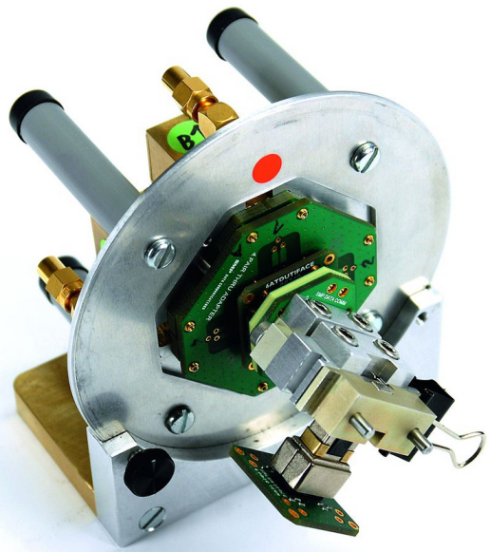
New Test Features
TDX and TDRL – can we Pass/Fail links ?
Unfortunately – No
Pass / Fail on TDX and TDRL is not possible since no cabling standard provides a test method with limits
  There are standards and limits for components, e.g. plugs
  However those are not applicable because they are only
  valid for the “normal” RL and crosstalk of components as
  such and are not valid if the component is connected to
  something else e.g. plugs are only measured against laboratory reference jigs when terminated to 100Ω
Note: This is very different to OTDR´s: A good OTDR can pass/fail a single event since there are standards and limits available to do so
Laboratory fixture
to test RJ45 plugs

Slide 35
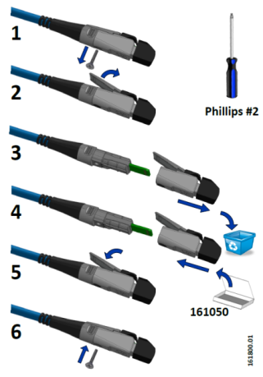
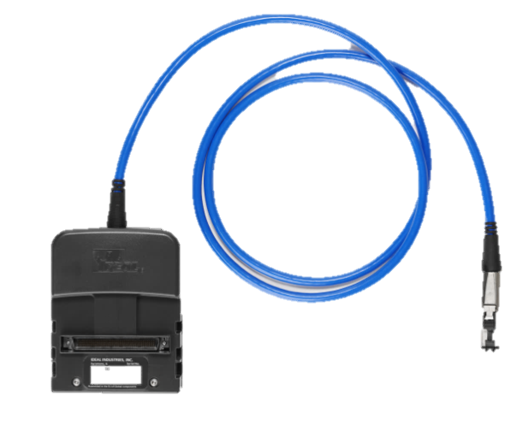
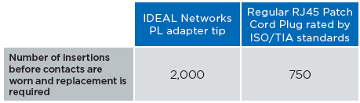
New Test Adapter
New permanent link adapter
CAT6_{A} RJ45 test plugs fulfils requirements for centred test plugs
Unique design
  Highly durable replacement tips to reduce cost of ownership
  Complete tip is a replacement part -> reduce risk to damage sockets with worn out test plugs
  Very low weight and flexible test cable, minimises torque on sockets when adapter is plugged in
  Very compact design for easy access to ports in narrow locations
NO MORE FIELD CAL
Reduction in cost of ownership – see next slide

Slide 36
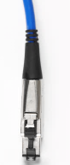
New Test Adapter
Why do we change from patented adapter-less testing to PL testing?
What really counts to the customer is not HOW we test but:
 | Adapter-less Testing | PL Testing
Simplicity | User has to choose the right cord for the right job User has to pay attention to field cal -> source for errors | Always the same adapter No field cal , plug & play
Durability | Patch cords suffer wear and tear not only the plug but also cord itself | Plugs have very high lifetime Adapter cord does not need replacement
Cost of ownership | CAT5e and CAT6 cords are relatively cheap, but quality CAT6A cords suitable for 500MHz tests are not cheap | Only tips need replacing Tips are more expensive than patch cords, but last much longer
✓

Slide 37
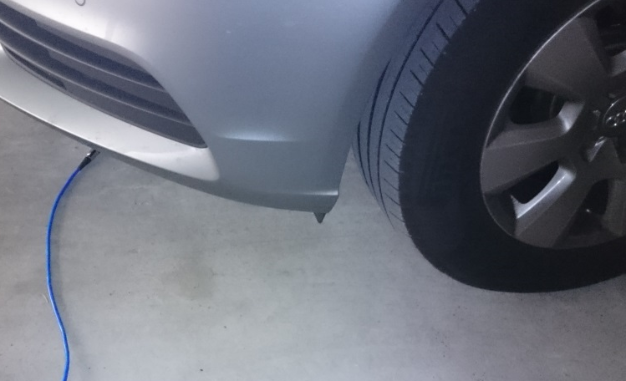
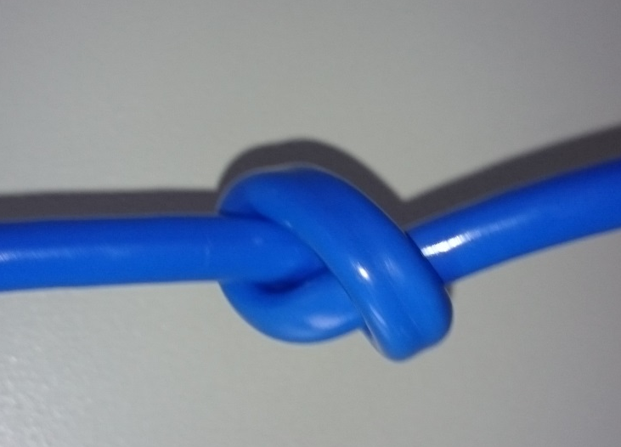
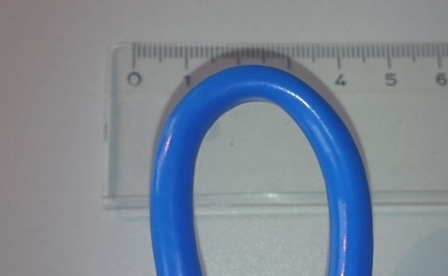
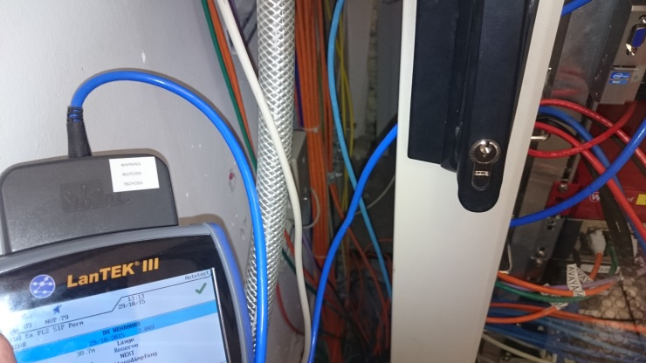
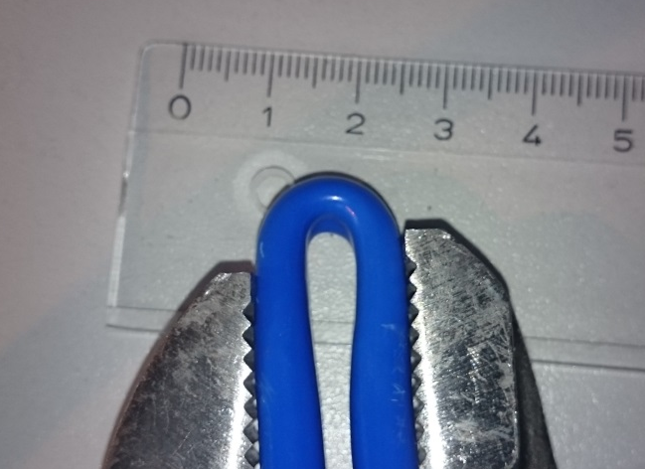
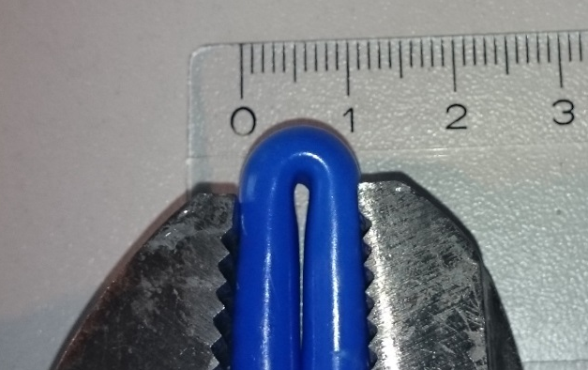
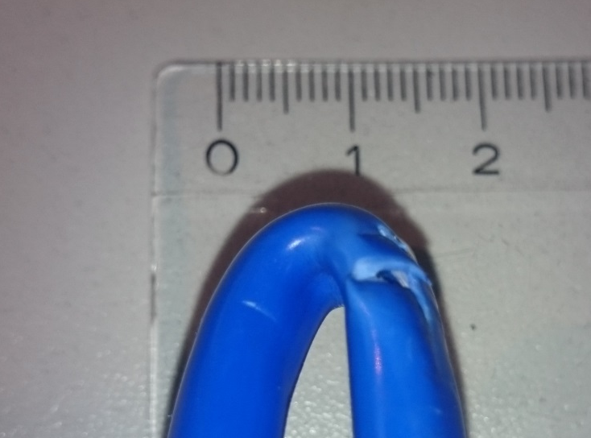
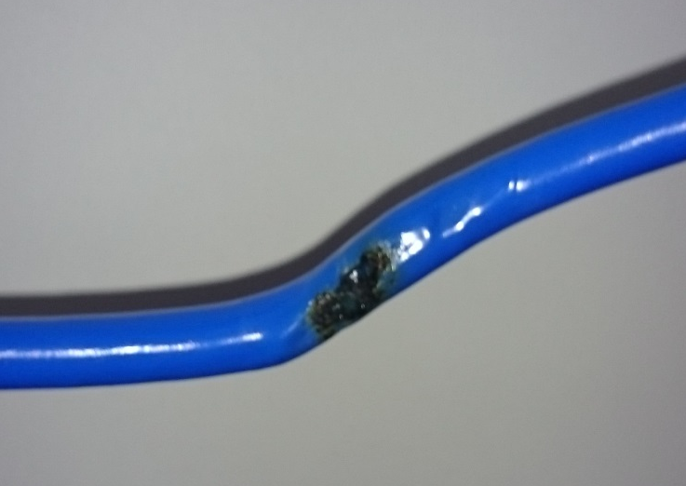
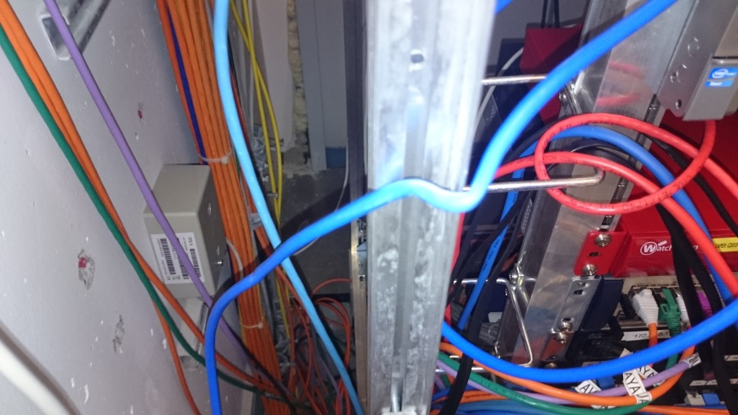
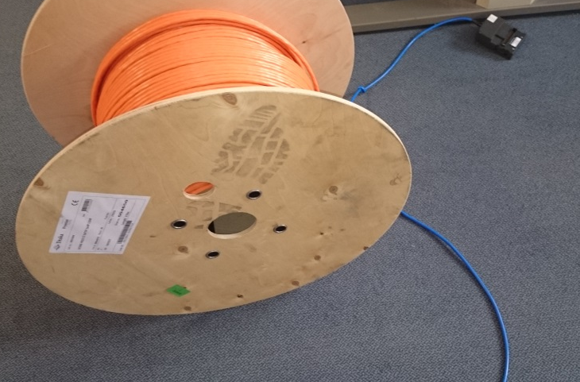
PL Adaptor Durability
PL adaptor mechanical tests to demonstrate durability
Test setup: 2 New PL adaptors, Reference Link 40m SSTP
Test # | Damage | Next Margin | RL Margin | IL
1 | No Damage, New Set | 9.5 | 5.8 | 23.7
2 | 30 Bends, 4 cm diameter | 9.7 | 5.7 | 23.7
3 | 1cm Bend with plier | 9.7 | 5.7 | 23.6
4 | Cable squeezed by plier | 9.7 | 5.7 | 23.7
5 | Cable squeezed in rack door | 9.5 | 5.7 | 23.6
6 | Cable stretched with ~ 50kg | 9.5 | 5.6 | 23.4
7 | Tight knot in cable | 9.4 | 5.8 | 23.5
8 | 30kg cable drum dropped on cable | 9.4 | 5.8 | 23.6
9 | 30kg cable drum 10x rolled over cable | 9.4 | 5.8 | 23.4
10 | Audi A6 front drove over cable | 9.4 | 5.8 | 23.4
11 | Cable jacked burned with hot air gun | 9.4 | 5.9 | 23.4

Slide 38
Accessories
Most accessories are compatible between LanTEK III and LanTEK II Series
  Exceptions
    PL adapters will not work on LanTEK II
    FiberTEK II adapters will not work on LanTEK III
  NEW PART NUMBERS!
    LanTEK III accessories will have new part numbers
    LanTEK III accessories are compatible with LanTEK II – new part numbers should be used.

Slide 39
IDC
New PC Software IDEAL DataCENTER 2.5 (IDC)
The new release supports the new test functions and comes with a number of large improvements
  TDX and TDRL support
  Sub projects: Up to 8 layers of sub directories in the logic of a campus site:
    Generic folder
      Project
        Site
          Building
            Telecommunication room
              Rack
                Panel

Slide 40
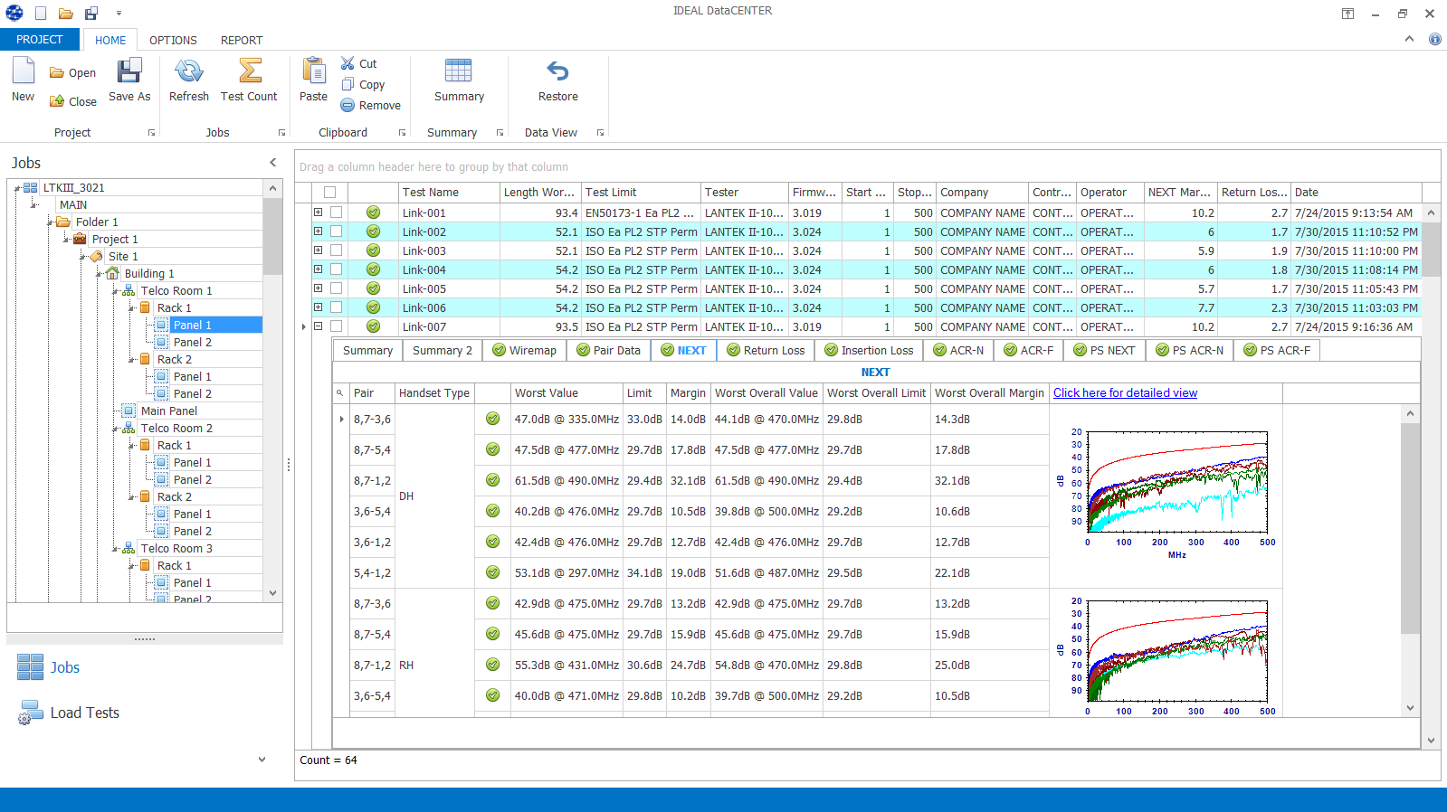
IDC

Slide 41
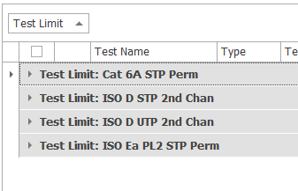
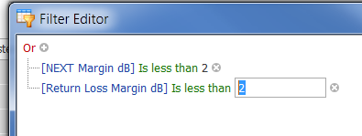

IDC
What else is cool about IDC?
  Datamining (see whitepaper on website)
    Sort, Group, Filter, Search
    for any data you need -> demo
  Copy data between databases
  Selective upload of data
  ( LTK II and LTK III, only via USB stick)
  IDC and cloud (see whitepaper on website)

Slide 42

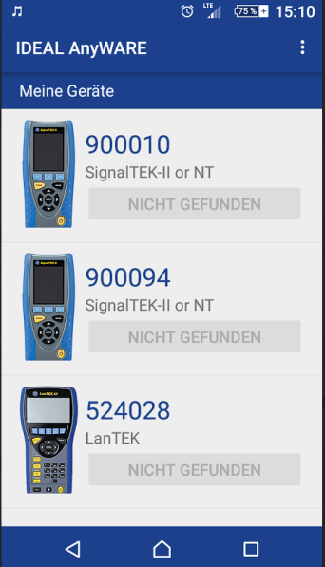


IDEAL AnyWARE app:
New wireless connection to smartphones (Apple and Android)
LanTEK III uses commercially available USB Wi-Fi dongles to act as a hotspot
Users with an IDEAL AnyWARE app can logon to download LanTEK III raw data
The test data can then be sent via e-mail or cloud services such as Google Drive or Dropbox to a user with IDEAL DataCENTER
Notes:
1) The cloud service has to be pre-installed on the Android or Apple device and users must have a valid account
2) The LanTEK III test data must be processed with the IDEAL DataCENTER software and cannot be viewed as such on the mobile device
3) 1 Wi-Fi adaptor shipped with unit

Slide 43
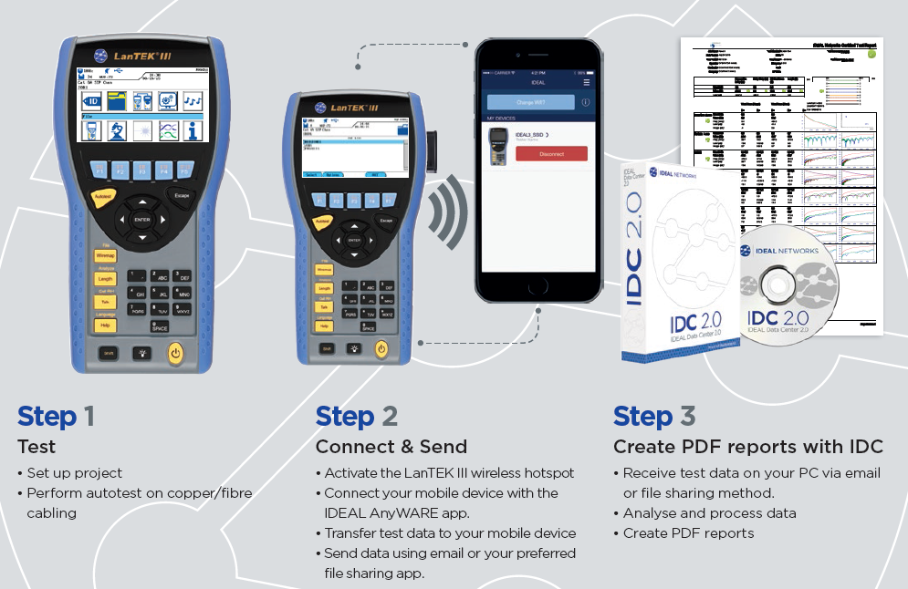

Test data when you want it,
where you want it

Slide 44
FAQ
Question | Answer
Will LanTEK III support RJ45 PL testing through CH adapters? | No This makes no sense since testing using CH adapters and patchcords actually is more expensive for CAT6A
Will LanTEKII support PL testing through the new PL adapters | No, the LanTEKII hardware can not support the new PL adapters
Do PL measurements of LTKIII and LTKII give same results? | Both devices are accurate to specs, however still may give different test results. When testing permanent links, the test plug is part of the link and therefore will have an influence on test results. Since the PL adapters of LTKIII have different electrical characteristics than a regular patchcord plug, there may be different test results, but again both are accurate to specs. Users may also see different test results when using patch cords since also patchcords can have different plug types.
Is TDX and TDRL specified as a mandatory test method in TIA568 or ISO 11801? | No, however both methods are very useful to locate faults along the cable and therefore optional tests in LanTEKIII
Can I test end-to-end links and device-links with LTKIII | Yes, both with LTKII and LTKIII
How many tests can I run with a set of PL tips? | According to standards, an RJ45 plug must withstand 750 insertions which is achievable for a quality patch cord. The tips of the LTKIII PL adapters are designed to withstand at least 2000 insertions under normal circumstances.
How often do I need to replace the PL adapters itself? | IDEAL uses a high quality and very durable but still lightweight cable. Under normal use, this part has not to be replaced during the lifetime of the product

Slide 45
FAQ
Question | Answer
Do I need to run a field calibration process to use the PL adapters? | No. Unlike with LTKII, there is no field calibration necessary for PL testing
When I buy a LTKIII only, can I already use that tester? | IDEAL offers configurations with and without test adapters so our customers have the freedom to chose whichever configuration best suits their needs. If you buy a LTKIII only, than this tester will be shipped without adapters. This case makes sense only if you already have a stock of LTKII or LTKIII adapters and do not need additional adapters
Channel adapters are sold as single pieces, PL tips are sold as pairs – why ? | When using channel adapters, it may happen that only one adapter gets damaged by a faulty patch cord. Therefore it makes sense to only offer single adapters. However, PL tips will only suffer wear due to a large number of insertions which most likely will always happen on both adapters , therefore both tips most likely will wear out same time. Therefore offering the tips as pairs makes more sense.
Which LTKIII models support fibre testing? | Both LTKIII500 and LTKIII1000 support FTKIII
Will LTKII support FTKIII? | Yes
Will LTKIII support FTKII? | No
Can I measure MPO connectors with FTKIII? | Not directly. Due to the still not very high repeatability when disconnecting and connecting MPO connectors, IDEAL still recommends to use so called fan-out cables from MPO to SC or LC. The same setup is used for OTDR measurements

Slide 46
FAQ
Question | Answer
Can I measure LC links with FTK III? | Yes, there are optional adapters available
Can LKTIII measure CAT8? | No – there is no testing standard nor cabling standard yet that defines testing of CAT8.
What cabling categories can I measure with LTKIII ? | Any category from CAT3 up to CAT6A with LTKIII500 and CAT3 to CAT7A with LTKIII1000
Does LTKIII have any troubleshooting functions | Yes. First of all, LTKIII features a wiremap with distance to fault to locate severe faults. Secondly LTKIII offers TDX and TDRL to locate crosstalk and returnloss faults along the link. This enables users to locate even small issues along the link.
Do you support cloud solutions | Yes, our system is open to many cloud solutions. LTKIII connects via Wi-Fi to our IDEAL AnyWARE app that runs on IOS and Android smartphones. The LTKIII data can be sent by a smartphone to any cloud or e-mail service that is installed on the users phone. We do not restrict the user to use a proprietary cloud solution.
Are LTKII and LTKIII accessories compatible | All copper testing accessories are compatible with two exceptions. 1) The new PL adapter can only be used on LTKIII and 2) LTKIII does not support PL measurements using CH adapters. Batteries, chargers and headsets are the same. The following other items can only be used with LTKIII: Wi-Fi adapter and IDEAL AnyWARE app.
Does IDC support LTKIII | Yes, from version 2.5 onwards. Users with version 1.x or 2.0x will need to upgrade to version 2.5 or higher.

Slide 47
FAQ
Question | Answer
Is the LTKIII troubleshooting able to locate shorts between a pin and the shield of shielded cables? | Yes. First of all, the wiremap distance to fault indicates the approximate location of a shield. Secondly, a short between a pin and shield causes a huge returnloss fault. The location of this fault can be accurately displayed by the TDRL feature
At consolidation point links, is LTKIII able to distinguish if a crosstalk error stems from the jack at the end of the link or from the consolidation point? | Yes. With the TDX feature, the user can see where there is a crosstalk problem along the cable. If the consolidation point contributes too much crosstalk, it will be visible in TDX. The user than can disconnect the extension from the consolidation point and re-test the link to verify if the link than meets specs or not.
If the cable itself was damaged during installation ( eg. excessive pull force), will LTKIII be able to locate this fault? | If it is a sever damage, eg. a ripped wire or the famous nail trough the cable, than yes, the wiremap distance to fault as well as TDRL will locate that fault. If it is a smaller damage and all wires are still connected, this question unfortunately can not be answered with a simple “yes” or “no”. A rule of thumb is: If a link fails the Autotest, than the user should be able to locate the fault with TDRL and or TDX. IF the link passes Autotest, than the damage is electrically so small that it actually does not matter for the performance of the cable, however such a link still might visually look damaged. As an example: One would think that a tight knot in an installation cable should cause the cable to fail the Autotest. However, most of the cables today are that stable, that even a know does not significantly reduce the performance of the link. In those cases it depends on how big the influence of the mechanical damage is to the returnloss and crosstalk performance. TDRL and TDX therefore might pick up the damage or not.
Which Wi-Fi adapters are supported by LTKIII | LTKIII is shipped with an EDIMAX EW-7811Un USB Wi-Fi adapter. Other adapters may work, but will not be supported by IDEAL.

Slide 48
Critical Questions
Objection | Solution
But.. LTKIII is not a CAT8 device | True. However, a) the standards at current are not even clear what parameters should be tested . A tester bought today carries a big risk to be not compliant to the future ratified CAT8 testing standard – do you really want to invest in the potentially wrong equipment ? b) CAT8 is 30 m maximum – this is purely a Datacentre application for 40Gbit/s. How many Datacentres do you serve that actually really plan to go copper for 40Gbit/s ?
But.. There is no OTDR module for LTKIII | We do have an OTDR in our range that is substantially better than any OTDR module for copper certifiers on the market AND is even less expensive. Our bundle of copper tester and OTDR is far more economically than our competitor. The additional benefit is that the company has two independently functioning units and not just 1 unit with 2 functions. Therefore 2 independent teams can work on copper and fibre in parallel whereas they would need to work in sequence using a modular system
But.. LTKIII has no touch screen | True – however our unit is designed for the rough environment where users need to operate units with hand gloves. Units with touch screen are more prone to downtime due to damages and can not be operated with hand gloves, specially when there is no other means of operating that unit without touch screen.
But.. IDEAL hosts no cloud services to share data | True, however, data from all our which are supported by our IDEAL Anyware App (devices like LTKIII ) can be send through all cloud or e-mail applications that are supported by IOS and Android Therefore our solution is much more open and does not limit the user to just one special service from one company
But… LTKIII is very slow | Yes, LTKIII is a few seconds slower than some other units on the market. However, the measurement process typically is not only influenced by the measurement speed but more so by other tasks like labelling, preparing the next link and so on.
But… LTKIII has no big colour display on the remote end | True, however, an additional big display also adds complexity to the product .- which we actually try to remove from the unit. The LanTEK user interface is an established system which we try not to change to radically.

Slide 49
Critical Questions
Objection | Solution
But.. Your ETL certificate only shows level IIIE / IV accuracy – what about level V? | True. At launch of the product, there was no ratified accuracy standard for level V accuracy. As a professional organisation, IDEAL will only refer to standards and not to draft standards that are not yet official
But… Will you ever have a level V ETL verification ? | Once the standard is ratified, IDEAL will take a commercial view on whether the investment in a level V certification program is commercially viable. A fact is that the number of CAT7A installations is on a strong downwards trend whereas CAT6A is on a strong upwards trend. At the time when level V is finally a ratified standard, it might as well be that CAT7A turned into an obsolete technology anyway.
But.. Your LTKIII almost looks like a LTKII – is it actually just old hardware in new plastics? | Actually, no. IDEAL made the careful decision to stay with a “LanTEKII-like” concept because this concept has proven to be very successful in terms of usability and durability. LanTEKIII is new hardware, with new TDRL and TDX measurement parameters for troubleshooting that had not been possible with the LKTII hardware.
But… you abandon PL testing with patch cords – why ??? Was Fluke right? | The patented way how LTKI&II measures PL with patch cords is a valid method. With LTKIII we decided to introduce a different method to measure PL due to the following reasons: a) the new method does not require any field cal process and therefore is easier to use. (plug & play) b) With wide deployment of CAT6A, the cost of wear parts for CAT6A testing becomes more an issue for users. When testing with patch cords, expensive quality cords need to be used and need to be replaced rather often. The new method features extremely durable and inexpensive replacement tips that at the end are less expensive than using patch cords.

Slide 50
Critical Questions
Objection | Solution
But.. The DTX1500 is cheaper | Is it really ? Are you aware that the basic price of the product does not include PL adapters that cost around €1200? A DTX1500 with PL adapters sits at a similar price as a LTKIII500 with PL adapters, but still offers no fibre option as our LTKIII500 does.
But.. Fluke offers a better service plan than you | The Gold plan is rather expensive. The biggest criteria in the field is downtime. We aim to have fast calibration times for all customers. If you want a guaranteed fast service time, we also offer a so called “careplan”. Another big feature of the gold plan is access to technical support and the knowledge base. We on the other hand offer free technical support and knowledgebase to any of our users, which is a key issue for users in the field.
What about MPO testing? | Unfortunately, the accuracy of MPO connectors as a connector on a measurement device is not very good, so repeatable measurements are questionable. IDEAL therefore recommends to always measure the complete channel, where typically the first and last connector is either an LC or SC. The same method is applied when measuring with OTDRs. This method is more cumbersome, but delivers more accurate results
But.. Your FKTIII does not support testing of single fibres like FTKII does | True. However, there had been changes in user preferences over the years to move from the “3 jumper calibration” to “1 jumper calibration”. Unfortunately, FTKII can due to its single fibre design not support the “1 jumper calibration” method. This method can only be supported if transmit and receive ports actually are different ports. Therefore FTKIII actually had to be a 2 port tester. ( Technical background : After calibration, the fibre cords must not be removed from the light source anymore. Since the only port on FTKII both is light source as well as power meter, a 1 jumper method can not be supported)

Slide 51
Critical Questions
Objection | Solution
But..Your LTKIII is pretty bulky and heavy | True, but what really counts in the field is uptime. Our tester works for 18 hours CONTINUOSLY , which means under typical usage for several days ( since testers rarely have to run continuously ) This is a substantially longer uptime than any competitor on the market. The price to pay on the other hand is that the batteries of the unit are not as small as other units on the market.
But, I have looked at the LTK user interface and I find it really confusing | Every user interface follows a different philosophy. Our user interface follows a fairly simple structure and aims to reduce complexity. Typically it does not take users long to find their way through. This is quite like if you are used to drive a Toyota and then switch to an Audi. It takes a moment or two to get accustomed to the new car.
Talking about UI´s, why can´t I have a UI like my IPhone? | We try our best to improve the UI as much as we can with the resources given. Companies developing smartphones can afford to employ a whole armada of software engineers that only work on the UI to improve the user experience. Certifiers, however , are sold only by the thousands and not by the millions like smartphones. Therefore the manpower we can invest in UI´s is limited.
But.. My friends / colleagues etc… use a DTX and are very happy with it | The DTX1800 was a very good product, no question. The DTX1800 is not any longer available and the successor DTX1500 only offers copper measurement while even our LTKIII500 offers fibre options. The successor DSX is a very pricy product – our LTKIII500 offers equally accurate CAT6A as well as fibre measurements at a much better price point

Slide 52
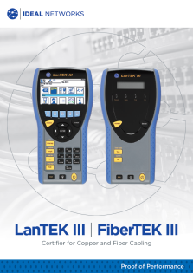
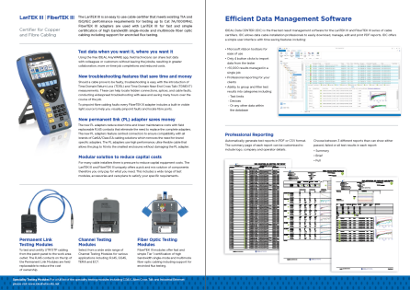
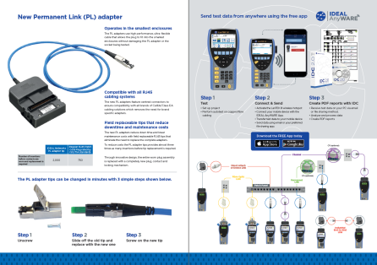



Marketing Material
All supporting documentation can be found stored on the SID under “LanTEK III” and “FiberTEK III”
Brochure - Eng, Fr, De
Product Photos
Application Photos
User Manual
Product Launch Plan LanTEK III and FiberTEK III
Press Release
Product Specifications
Price Lists

Slide 53
Service
Factory calibration
IDEAL recommends annual factory calibration
LanTEK III
  LanTEK II ATE´s can also calibrate LanTEK III, however
  all LanTEKII ATE´s must be upgraded in Stokenchurch to be able to calibrate LanTEK III
    New software
    New calibration artefacts
    New reference testing links
FiberTEK III
  There is a new calibration equipment for FiberTEK III
  Due to the cost of the calibration equipment, all FiberTEK III will be calibrated in Stokenchurch

